Slide 1
Investigation of Graph Neural Networks
Name — Vishal Kumar
Course – MSc. Computer Science – Intelligent Systems
Student ID - 19304373
Supervised by – Rozenn Dahyot

Slide 2
Overview, Motivation and Work Progression
Notes:
Discuss-
Problem statement
Motivation
Analysis

Slide 3
Overview
The research work aims to explore and investigate -
Graph representations of information.
Architectures to process graph structured data
Understanding architecture design
Learning and decision making process
Variants of Applications
Python Graph libraries
Graph Model Implementations
Notes:
The architecture built in this research aims to reduce decision making time in providing decision making in real time, solutions to big data problems, cloud computing

Slide 4
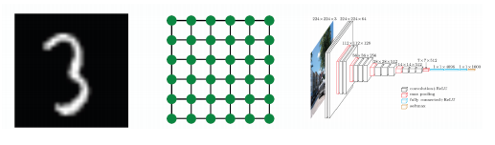
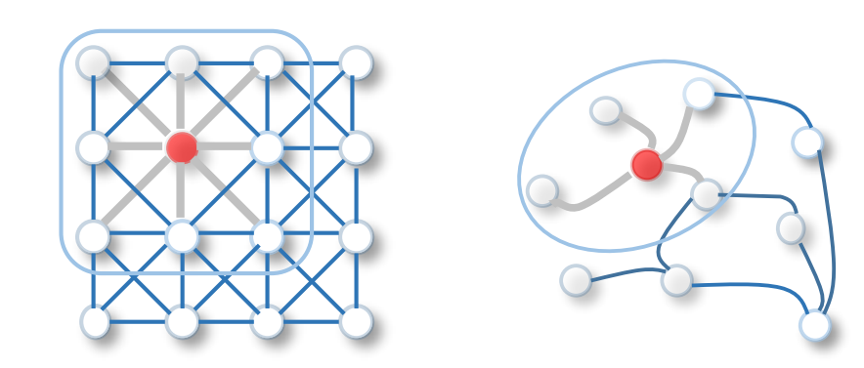


MOTIVATION
Inability of CNNs to handle Non-Euclidean data
Networks are more complex
A Comprehensive Survey on Graph Neural Networks Zonghan Wu, Shirui Pan
Notes:
Inability of CNNs to handle Non-Euclidean data as modern deep learning approaches are designed for simple sequences or grids
But networks are far more complex, as they donot have spatial locality like grids, no node ordering, and may be dynamic in nature.

Slide 5
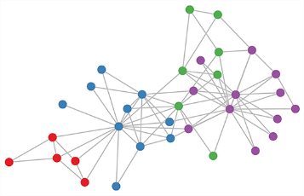
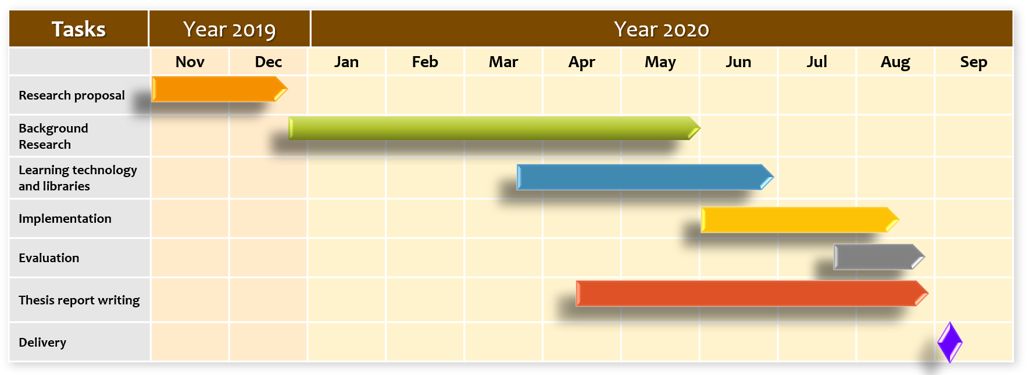
RESEARCH PROGRESSION
Notes:
The architecture built in this research aims to reduce decision making time in providing decision making in real time, solutions to big data problems, cloud computing

Slide 6
Literature Review and State-of-the-art

Slide 7
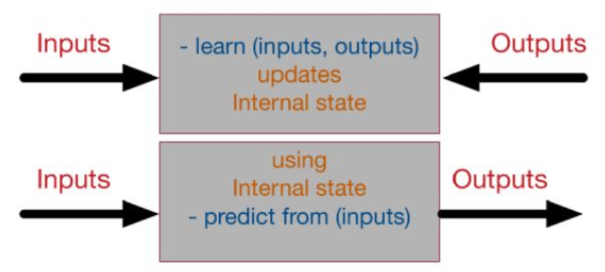
Literature Review and State-of-the-art
1. Neurons and Neural Networks
Black box view of the neural network
Notes:
In traditional machine learning models, the neural network holds a position that is compared to most of the benchmark algorithms
In training, a typical neural network in the machine learning domain tries to learn from given inputs.
Starts with random values (called weights), these weights are updated continuously using commonly used algorithms.

Slide 8
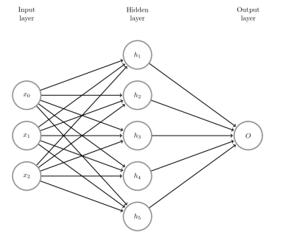
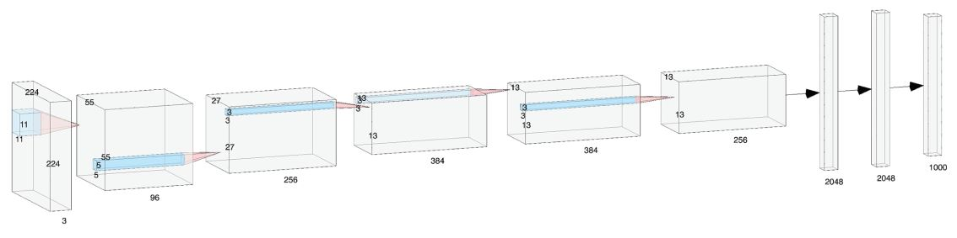
Literature Review and State-of-the-art
1. Neurons and Neural Networks
A. Feed-forward neural network B. Convolutional neural network
Multi-layered FNN (Sazli, 2006)
Alexnet (Krizhevsky, Sutskever, and G. E. Hinton, 2012)
Notes:
To improve performance and achieve generalization,
most of the researches are focused on different learning algorithms and model architectures.
These architectures are grouped into four categories as:
First feedward neural network
Convolutional neural network

Slide 9
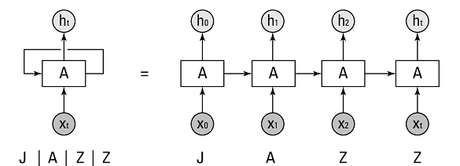
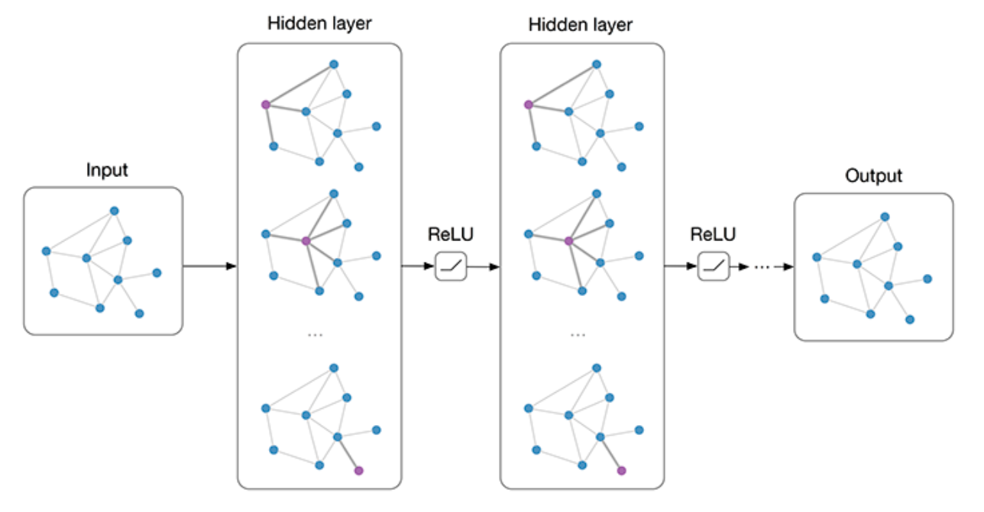
Literature Review and State-of-the-art
1. Neurons and Neural Networks
C. Recurrent neural network D. Graph neural network
A folded and unfolded RNN cell
Graph Convolutional Network (kipf, 2016)
https://www.dummies.com/programming/big-data/data-science/deep-learning-and-recurrent-neural-networks/
Notes:
Third as Recurrent neural network,( here showing, folded and unfolded RNN cell processing a sequence input.)
GNNs are specifically designed to handle graphical data non-Euclidean data structures.

Slide 10
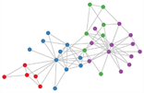
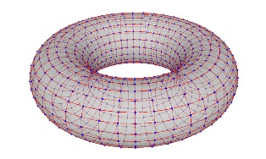
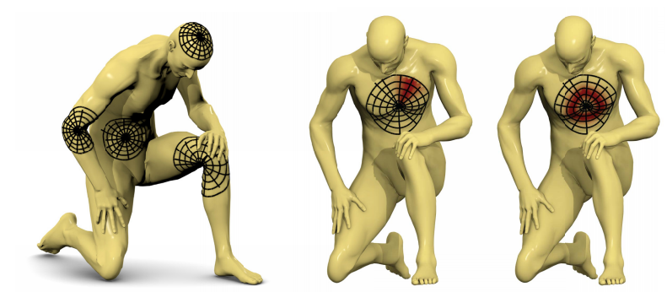
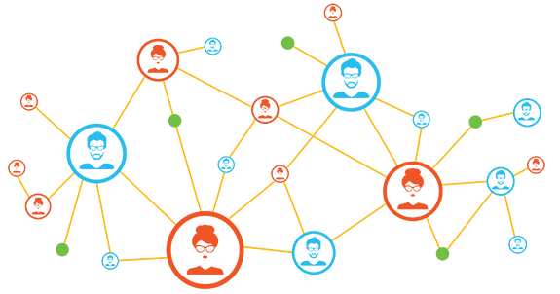
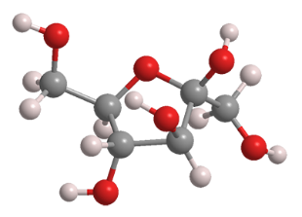
Literature Review and State-of-the-art
2. Geometric deep learning
A. Deep learning models for manifolds
B. Deep learning models for graphs*
Torus
Riemannian manifolds
(Masci et al., 2015) ➔Geodesic convolutional neural networks on Riemannian manifolds
Chemical Molecule
Social network
Geodesic convolutional neural networks on Riemannian manifolds Jonathan Masci
https://m16marketing.com/atlanta-social-media-company/
https://www.acs.org/content/acs/en/molecule-of-the-week/archive/f/fructose.html
https://towardsdatascience.com/manifolds-in-data-science-a-brief-overview-2e9dde9437e5
Notes:
Geometric deep learning is a group of emerging techniques- to generalize deep learning models of structured or Euclidean domains ---> to graphs or manifolds in non-Euclidean domains
GDL can be categorized into two groups
Deep learning models for manifolds
For Riemannian manifolds authors utilize geodesic polar coordinates to apply local patch filter and
introduces an intrinsic type of CNN for manifolds that can achieve state-of-the-art performance for applications as description and retrieval of shapes
Deep learning models for graphs
Manifolds are spaces which are locally Euclidean in nature
**************************
Geodesic: relating to or determined by geodesy
Geodesy: The branch of geology that studies the shape of the earth and the determination of the exact position of geographical points

Slide 11
Literature Review and State-of-the-art
3. Graph Neural Network variants
A. Models based on graph types
Directed Graph : (Bruna et al., 2013) ➔ Spectral networks and locally connected networks on graphs
Heterogeneous graphs: (Y. Zhang et al., 2018) ➔ Deep collective classification in heterogeneous information networks
Dynamic graphs: (Yaguang Li et al.,2017) ➔ Diffusion convolutional recurrent neural network: Data-driven traffic forecasting
Graphs with edge information: (Beck, Haffari, and Cohn, 2018) ➔ Graph-to-sequence learning using gated graph neural networks
Notes:
Models are groups based on graph types as: <<SLIDE>>
*****************************************
For directed graphs, When graph size becomes more significant, distribution of information from distant nodes can suffer from the problem of information dilution (Bruna et al., 2013) + (Bruna et al., 2013) introduces a Dense Graph propagation to avoid this problem by designing direct communication links for distant nodes.

Slide 12
Literature Review and State-of-the-art
3. Graph Neural Network variants
Models based on Propagation methods
Convolution: `MoNet’ (Monti et al., 2017) ➔Geometric Deep Learning on Graphs and Manifolds Using Mixture Model CNNs
Gate: (Zhuang and Q. Ma, 2018) ➔ Dual graph convolutional networks for graph-based semi-supervised classification
Attention: (Veličković et al., 2017) ➔ Graph attention networks
Skip Connection: (He et al., 2015) ➔ Deep residual learning for image recognition
Notes:
Some researches use a unique aggregator to collect data from neighbours of nodes and different updater modules to modify the implicit state of nodes.
This variety in propagation steps results in a variety of GNNs as <<SLIDE>>
***********************
Gates are just neural networks that regulate the flow of information flowing through the sequence chain.
LSTM's and GRU's are used in state of the art deep learning applications like speech recognition, speech synthesis, natural language understanding, etc
A neural network is considered to be an effort to mimic human brain actions in a simplified manner.
Attention Mechanism is also an attempt to implement the same action of selectively concentrating on relevant things, while ignoring others in deep neural networks
Skip connections in deep architectures, as the name suggests,
skip some layer in the neural network and feeds the output of one layer as the input to the next layers (instead of only the next one).

Slide 13
Literature Review and State-of-the-art
3. Graph Neural Network variants
B. Models based on Propagation methods
Convolution: `MoNet’ (Monti et al., 2017) ➔Geometric Deep Learning on Graphs and Manifolds Using Mixture Model CNNs
Gate: (Zhuang and Q. Ma, 2018) ➔ Dual graph convolutional networks for graph-based semi-supervised classification
Attention: (Veličković et al., 2017) ➔ Graph attention networks
Skip Connection: (He et al., 2015) ➔ Deep residual learning for image recognition
Notes:
Some researches use a unique aggregator to collect data from neighbours of nodes and different updater modules to modify the implicit state of nodes.
This variety in propagation steps results in a variety of GNNs as <<SLIDE>>
***********************
Gates are just neural networks that regulate the flow of information flowing through the sequence chain.
LSTM's and GRU's are used in state of the art deep learning applications like speech recognition, speech synthesis, natural language understanding, etc
A neural network is considered to be an effort to mimic human brain actions in a simplified manner.
Attention Mechanism is also an attempt to implement the same action of selectively concentrating on relevant things, while ignoring others in deep neural networks
Skip connections in deep architectures, as the name suggests,
skip some layer in the neural network and feeds the output of one layer as the input to the next layers (instead of only the next one).

Slide 14
Literature Review and State-of-the-art
3. Graph Neural Network variants
C. Models based on training methods
Sampling Hierarchical Pooling
Data Augmentation Unsupervised training
Notes:
GNNs can also be grouped based on method of training and optimization steps.
***********************
Data sampling refers to statistical methods for selecting observations from the domain with the objective of estimating a population parameter.
Role of pooling layer is to reduce the resolution of the feature map but retaining features of the map required for classification.
Design pooling layer based on hierarchy on nodes.
Data augmentation is a strategy to significantly increase the diversity of data available for training models, without actually collecting new data.
Data augmentation techniques such as cropping, padding, and horizontal flipping are commonly used to train large neural networks.
Unsupervised training: looks for previously undetected patterns in a data set with no pre-existing labels and with a minimum of human supervision

Slide 15
Literature Review and State-of-the-art
3. Graph Applications
A. Structured scenarios
- where the data are naturally available in the graph structure
- such as social network prediction, traffic prediction, recommender systems, and graph representation
Notes:
Physics: Battaglia et al. [2016] propose Interaction Networks to make predictions and inferences about various physical systems
Chemistry & Biology: (Duvenaud et al., 2015) proposed neural graph fingerprints which calculate substructure feature vectors and sum to get overall representation.
Knowledge Graph Completion : Author proposes the first GNN-based framework for modeling relational data with parameter sharing techniques to enforce sparsity constraints.
Recommender Systems:

Slide 16
Literature Review and State-of-the-art
3. Graph Applications
B. Non-Structured scenarios
- where the data are NOT naturally in the graph structure.
- such as image, text, programming source code, and multi-agent systems.
Notes:
Physics: Battaglia et al. [2016] propose Interaction Networks to make predictions and inferences about various physical systems
Chemistry & Biology: (Duvenaud et al., 2015) proposed neural graph fingerprints which calculate substructure feature vectors and sum to get overall representation.
Knowledge Graph Completion : Author proposes the first GNN-based framework for modeling relational data with parameter sharing techniques to enforce sparsity constraints.
Recommender Systems:

Slide 17
Model Designs and Libraries

Slide 18
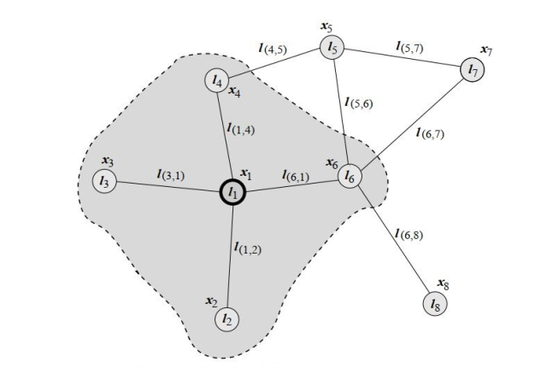
Model Designs and Libraries
1. Original(vanilla) Graph neural network
The vanilla GNN (Scarselli et al., 2009)➔ The graph neural network model
Transduction function: τ(G, n) ∈ R^{m}
graph ‘G’ is denoted as pair (N, E)
ne[n] : Set of neighbour nodes connected to node ‘n’
co[n] : set of edges with node ‘n’
Each node and edges may have labels and input features
l_{n} : labels for node ‘n’
l_{(n1,n2)} : labels for edge (n1,n2)
Notes:
Author proposes a new neural network model, called graph neural network (GNN) model, that extends existing neural network methods for processing the data represented in the graph domain.
implements a transduction function τ(G, n) ∈ IRm that maps a graph G and one of its nodes n into an m-dimensional Euclidean space.
***********************
Transduction: the process of transferring genetic material from one cell to another by a plasmid or bacteriophage

Slide 19
Model Designs and Libraries
1. Original(vanilla) Graph neural network
Motive: learning the node or state embedding x_{n} , which acts as encoded information based on neighbour nodes of ‘n’
Two parametric functions :
‘f’ and `g’ - ‘local transition function’ and ‘local output function’
state embedding: x_{n} = f (l_{n}, l_{co[n]}, x_{ne[n]}, l_{ne[n]})
output of node `n’: o_{n} = g(x_{n}, l_{n})
Notes:
Author proposes a new neural network model, called graph neural network (GNN) model, that extends existing neural network methods for processing the data represented in the graph domain.
implements a transduction function τ(G, n) ∈ IRm that maps a graph G and one of its nodes n into an m-dimensional Euclidean space.
***********************
Transduction: the process of transferring genetic material from one cell to another by a plasmid or bacteriophage

Slide 20
Model Designs and Libraries
1. Original(vanilla) Graph neural network
In order to implement the GNN model, the following items must be provided:
A method to solve Eq. on = g(xn,ln)
A learning algorithm to adapt fw and gw
An implementation of fw and gw.
Limitation:
Learning algorithm requires iteration for time T to update node ➔computationally expensive process.
Notes:
Author proposes a new neural network model, called graph neural network (GNN) model, that extends existing neural network methods for processing the data represented in the graph domain.
implements a transduction function τ(G, n) ∈ IRm that maps a graph G and one of its nodes n into an m-dimensional Euclidean space.
***********************
Transduction: the process of transferring genetic material from one cell to another by a plasmid or bacteriophage

Slide 21
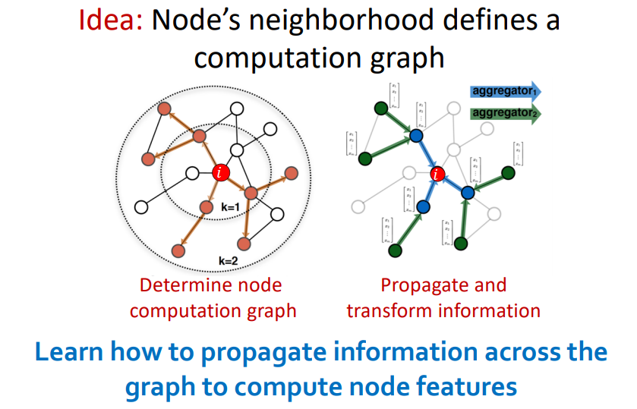
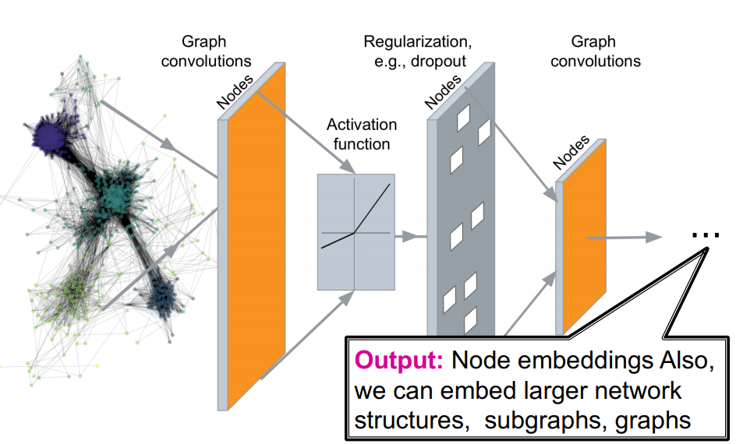
Model Designs and Libraries
2. Graph convolutional network
T. N. Kipf and M. Welling. 2017. Semi-supervised classification with graph convolutional networks.

Slide 22
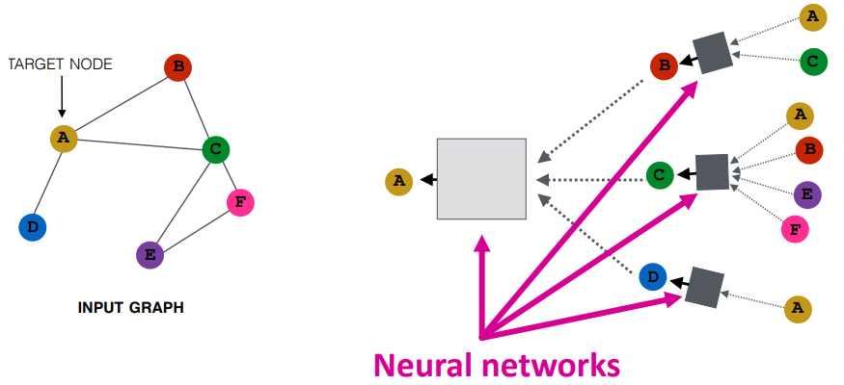
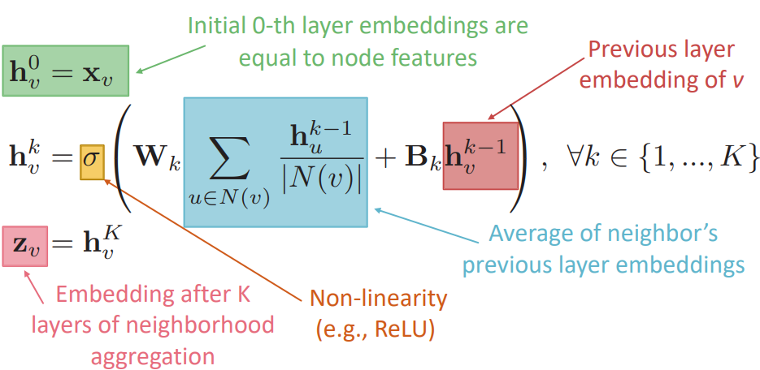
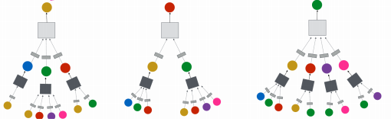
Model Designs and Libraries
2. Graph convolutional network
Idea: Aggregate Neighbour ➔ Generate node embeddings based on local network neighborhoods
Box: average messages from neighbors + apply neural network
Layer 1
Layer 2
Layer 0

Slide 23

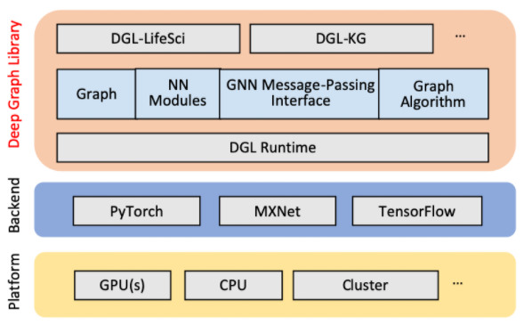
Model Designs and Libraries
3. Graph Libraries
For instance, implementation of GraphConv module: one Graph Convolutional layer
A. Deep Graph Library (DGL)
- Framework: open-source, easy-to-use, high performance and scalable
for deep learning on graphs.
- based on PyTorch, Apache MXNet or TensorFlow.
- provide implementations of popular GNN layers under subpackage
dgl.<backend>.nn.
Notes:
GNNs can also be grouped based on method of training and optimization steps.
***********************
Data sampling refers to statistical methods for selecting observations from the domain with the objective of estimating a population parameter.
Role of pooling layer is to reduce the resolution of the feature map but retaining features of the map required for classification.
Design pooling layer based on hierarchy on nodes.
Data augmentation is a strategy to significantly increase the diversity of data available for training models, without actually collecting new data.
Data augmentation techniques such as cropping, padding, and horizontal flipping are commonly used to train large neural networks.
Unsupervised training: looks for previously undetected patterns in a data set with no pre-existing labels and with a minimum of human supervision

Slide 24
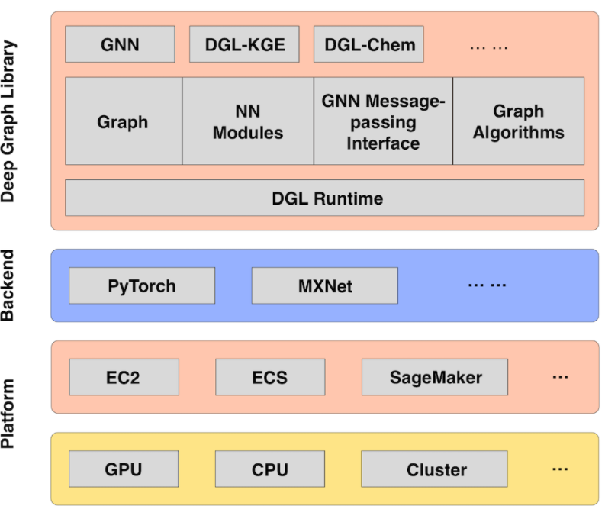
Literature Review and State-of-the-art
3. Graph Libraries
A. Deep Graph Library (DGL)
AWS Deep Graph Network
- AWS Sagemaker: a fully managed machine learning service
- provides DGL containers in Amazon Elastic Container Registry (Amazon ECR)
Notes:
GNNs can also be grouped based on method of training and optimization steps.
***********************
Data sampling refers to statistical methods for selecting observations from the domain with the objective of estimating a population parameter.
Role of pooling layer is to reduce the resolution of the feature map but retaining features of the map required for classification.
Design pooling layer based on hierarchy on nodes.
Data augmentation is a strategy to significantly increase the diversity of data available for training models, without actually collecting new data.
Data augmentation techniques such as cropping, padding, and horizontal flipping are commonly used to train large neural networks.
Unsupervised training: looks for previously undetected patterns in a data set with no pre-existing labels and with a minimum of human supervision

Slide 25


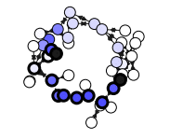
Literature Review and State-of-the-art
3. Graph Libraries
B. Spektral
- Python library for graph deep learning, based on the Keras API and TensorFlow 2.
C. PyTorch Geometric
- PyG is a geometric deep learning extension library for PyTorch.
D. Graph Nets
- DeepMind's library for building graph networks in Tensorflow and Sonnet.
Notes:
GNNs can also be grouped based on method of training and optimization steps.
***********************
Data sampling refers to statistical methods for selecting observations from the domain with the objective of estimating a population parameter.
Role of pooling layer is to reduce the resolution of the feature map but retaining features of the map required for classification.
Design pooling layer based on hierarchy on nodes.
Data augmentation is a strategy to significantly increase the diversity of data available for training models, without actually collecting new data.
Data augmentation techniques such as cropping, padding, and horizontal flipping are commonly used to train large neural networks.
Unsupervised training: looks for previously undetected patterns in a data set with no pre-existing labels and with a minimum of human supervision

Slide 26
Implementation & Technical details

Slide 27
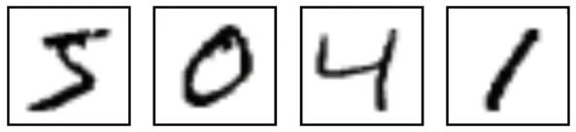
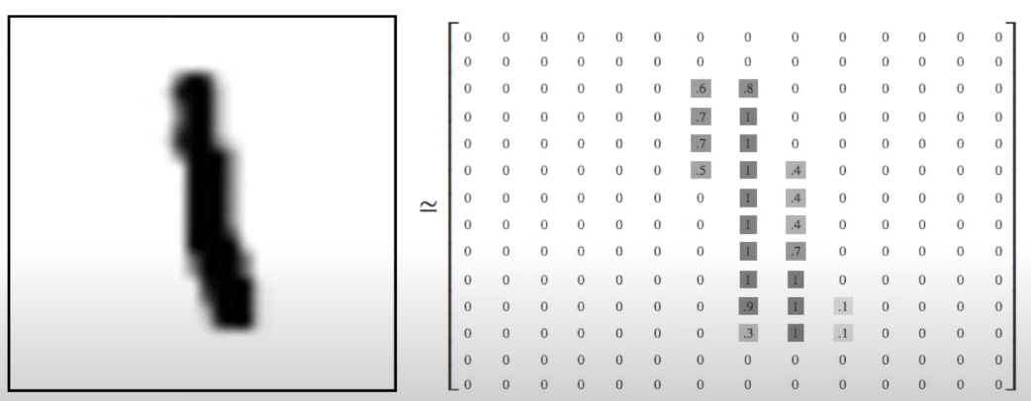
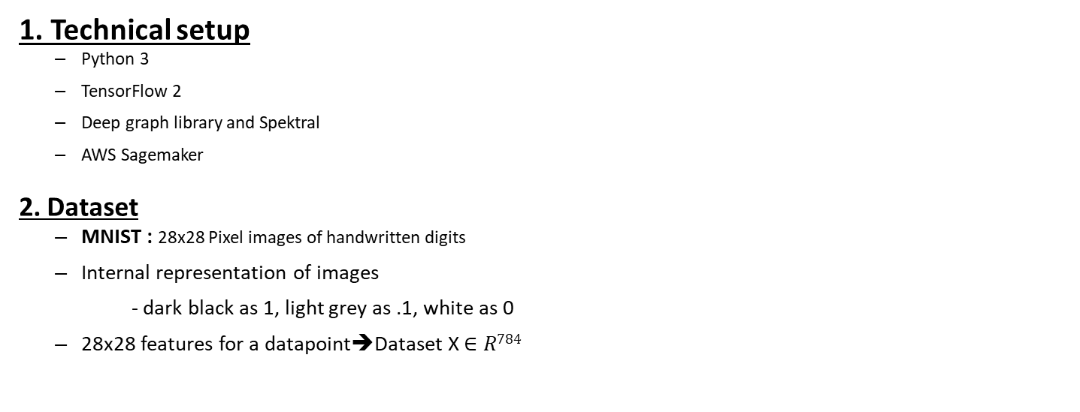
Implementation & Technical details
1. Technical setup
Python 3
TensorFlow 2
Deep graph library and Spektral
AWS Sagemaker
2. Dataset
MNIST : 28x28 Pixel images of handwritten digits
Internal representation of images
- dark black as 1, light grey as .1, white as 0
28x28 features for a datapoint➔Dataset X $∈R784$
Notes:
Physics: Battaglia et al. [2016] propose Interaction Networks to make predictions and inferences about various physical systems
Chemistry & Biology: (Duvenaud et al., 2015) proposed neural graph fingerprints which calculate substructure feature vectors and sum to get overall representation.
Knowledge Graph Completion : Author proposes the first GNN-based framework for modeling relational data with parameter sharing techniques to enforce sparsity constraints.
Recommender Systems:

Slide 28
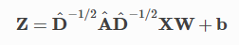
Implementation & Technical details
3. Spektral Library APIs:
spektral.datasets.mnist.load_data(k)
- Takes argument: k- number of neighbourhood nodes
- Returns training, validation, testing nodes features and labels + Adjacency matrix.
spektral.layers.GraphConv(channels, activation ……..)
- Implements a graph convolutional layer (GCN) as presented by Kipf & Welling (2016).
- computes :
Notes:
Loads the MNIST dataset and a K-NN graph to perform graph signal classification
node features of each graph are the MNIST digits vectorized and rescaled to [0, 1]. Two nodes are connected if they are neighbours according to the K-NN graph. Labels are the MNIST class associated to each sample.
Takes Arguments:
k: int, number of neighbours for each node;
noise_level: fraction of edges to flip (from 0 to 1 and vice versa);
Return
X_train, y_train: training node features and labels;
X_val, y_val: validation node features and labels;
X_test, y_test: test node features and labels;
A: adjacency matrix of the grid;
Implements a graph convolutional layer (GCN) as presented by Kipf & Welling (2016).
This layer computes Z node state,
A^=A+I is the adjacency matrix with added self-loops and D^ is its degree matrix.
******************
The K-NN graph is statically determined from a regular grid of pixels using the 2d coordinates.

Slide 29
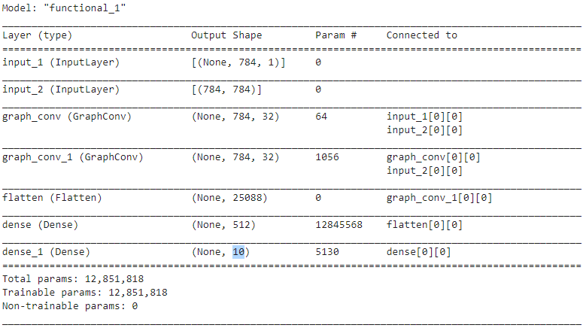
Implementation & Technical details
3. Classification Architecture:
Notes:
Loads the MNIST dataset and a K-NN graph to perform graph signal classification
node features of each graph are the MNIST digits vectorized and rescaled to [0, 1]. Two nodes are connected if they are neighbours according to the K-NN graph. Labels are the MNIST class associated to each sample.
Takes Arguments:
k: int, number of neighbours for each node;
noise_level: fraction of edges to flip (from 0 to 1 and vice versa);
Return
X_train, y_train: training node features and labels;
X_val, y_val: validation node features and labels;
X_test, y_test: test node features and labels;
A: adjacency matrix of the grid;
Implements a graph convolutional layer (GCN) as presented by Kipf & Welling (2016).
This layer computes Z node state,
A^=A+I is the adjacency matrix with added self-loops and D^ is its degree matrix.
******************
The K-NN graph is statically determined from a regular grid of pixels using the 2d coordinates.

Slide 30
Result, Analysis & Conclusion

Slide 31
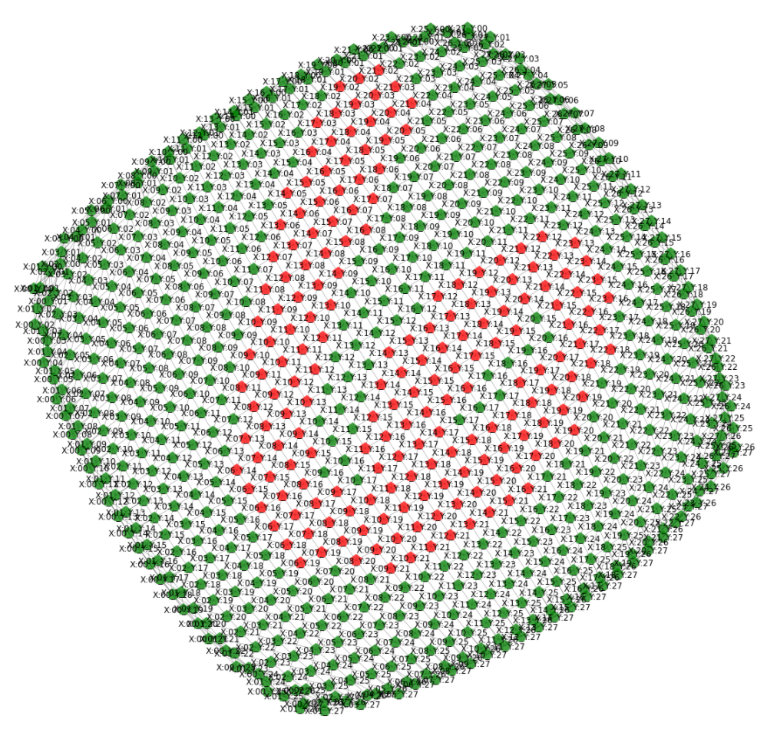
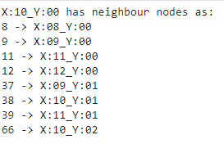
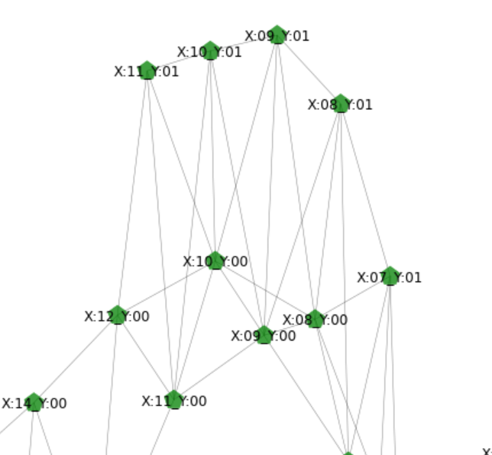
Result, Analysis & Conclusion
1. Graph data generation :
- using Image transformations
Notes:
Physics: Battaglia et al. [2016] propose Interaction Networks to make predictions and inferences about various physical systems
Chemistry & Biology: (Duvenaud et al., 2015) proposed neural graph fingerprints which calculate substructure feature vectors and sum to get overall representation.
Knowledge Graph Completion : Author proposes the first GNN-based framework for modeling relational data with parameter sharing techniques to enforce sparsity constraints.
Recommender Systems:

Slide 32
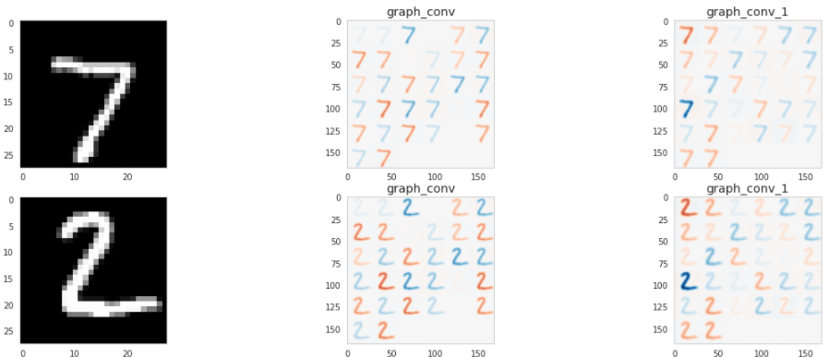
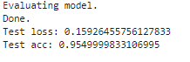
Result, Analysis & Conclusion
2. Model Result:
Intermediate output at GCN layers
GCN layers successfully identified graphical
representation of digits, are able to
make correct decision.
Final result:
Notes:
Here rearranged the output of the graph convolutions to see if the model is learning similar sorts of features to the standard convolutional neural networks
*******************
loss is a number indicating how bad the model's prediction was on a single example.
Unlike accuracy, a loss is not a percentage. It is a sum of the errors made for each example in training or validation sets

Slide 33
CONCLUSION
GNN is very powerful tool to analyze structured or non-structured graph data.
It enables modeling complex graph structures.
It can potentially improve neural networks applications performance.
Applications are not limited to only problems in graphs - can be easily generalized to many studies that can be modeled by graphs.
GNNs will see application in increasingly wider areas of machine learning and computer vision.
GNN is still a relatively new area and getting more research attention.
Trinity College Dublin, The University of Dublin

Slide 34
Future Work
If more time was permitted, graph structures with higher complexity can be modelled with evaluation based on other performance metrics.
Comparison with other benchmark models can be made.
Model generalization can explored and tested on different graph data.
Scalabilty limit of model can be measured based on number of GCN layers.
Modelling a dynamic graph will be a milestone for general GNN.
Trinity College Dublin, The University of Dublin
Notes:
***********
Static graphs are stable so they can be modeled feasibly, while dynamic graphs introduce changing structures. When edges and nodes appear or disappear, GNN cannot change adaptively.

Slide 35
Thank you

Slide 36
Thank you

Slide 37
Thank you

Slide 38
Thank You

Slide 39
Prediction tasks on networks:
- Node-centric applications of GCNs (learn labels or representations for nodes in a graph):
Semi-supervised node classification:
Node representation learning:
- Graph-centric applications of GCNs (learn labels or representation for graphs given node features and graph structure)
Graph signal processing (classification/regression)
Representation learning for graphs:
Notes:
The architecture built in this research aims to reduce decision making time in providing decision making in real time, solutions to big data problems, cloud computing

Slide 40
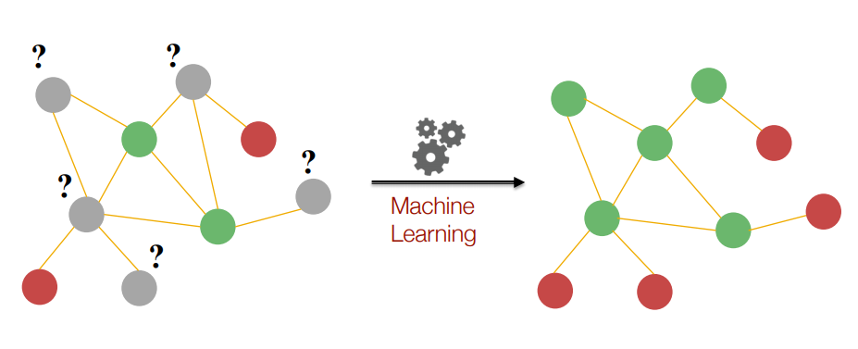
Prediction tasks on networks:
1. Node Classification
Notes:
If we have to perform some predictive tasks on network,
then first example would be Node classification,
Given: Here we have graph semi labelled nodes, as green and red
Question is: how should we assign colors to unlabelled gray nodes.
Using some learning method we have to classify nodes as green or red.

Slide 41
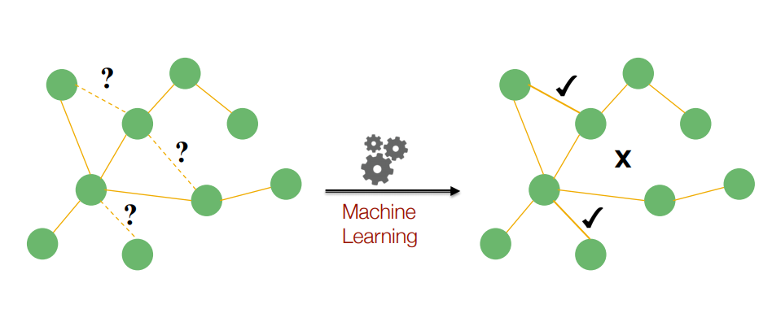
Prediction tasks on networks:
2. Link Prediction
Jure Leskovec, Stanford CS224W: Analysis of Networks, http://cs224w.stanford.edu
Notes:
2nd type
Given is: some links are observed and some are missing.
Question is : to predict which links are missing in network

Slide 42
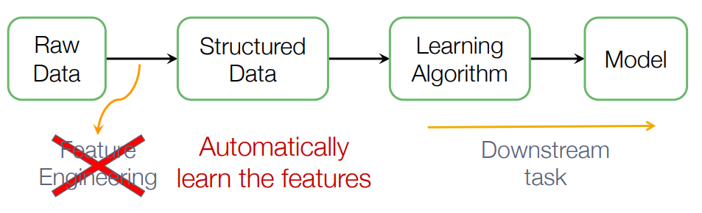
Machine learning lifecycle:
Jure Leskovec, Stanford CS224W: Analysis of Networks, http://cs224w.stanford.edu
Notes:
Mostly in such tasks we have to do feature engineering from raw data to structured data. But we would like to do this automatically.

